Slide 1
[DECHAIN-Vehicle Connected Blockchain]
Team Name: Encrypteam Team Member:
I Gusti Bagus Awienandra
Ignatio Julian
Adnan Wisudhaputra
Yeremia Yudha
Vincentius Nicholas

Slide 2
1. SUMMARY
Short pitch for your app (max 200 words) Dechain is a vehicle data analysis apps that gather the data of the vehicle condition. In the beginning the user could track their mileage, fuel consumption and car latest location. Our connection with third party services, make user could predict their annual cost of vehicle and get notify as we partner with the local service center. The user also could predict their flexible insurance fare as we also partner with the insurance provider. If the user want to sell their car or looking for used car we also provide best used car based on data as we also partner with the marketplace.
What does your application solve? Dechain is solve the fraud of vehicle data condition and make sure the authenticity of the vehicle data. Also provide the user with the best vehicle data analysis as possible start from the trip annual cost to the insurance annual bill.
How do you solve it? We create a platform that the user could see the visualization of their vehicle data.
What makes your application unique? It give the user whole new ways to see their vehicle without knowing the technical data of their vehicle.
Who is it for? People or Organizations who can access internet and are having vehicle.
Who are your ideal partners? Vehicle Marketplace, Vehicle Service Center, Vehicle Production Company, IOT Manufacturer, Insurance Company
How do you make money? We charge the data subscription and apps subscription

Slide 3
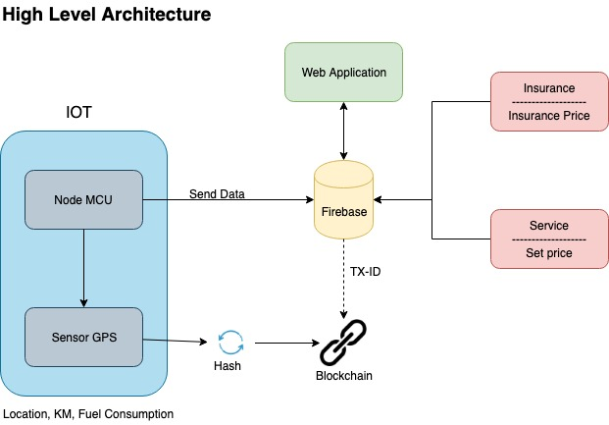
2. High Level Architecture

Slide 4
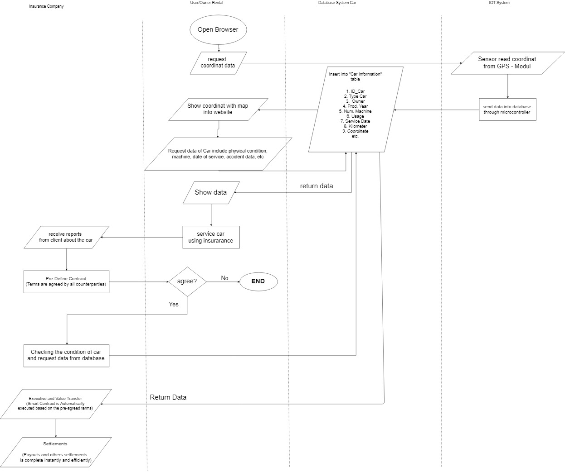
3. APPLICATION FLOW

Slide 5
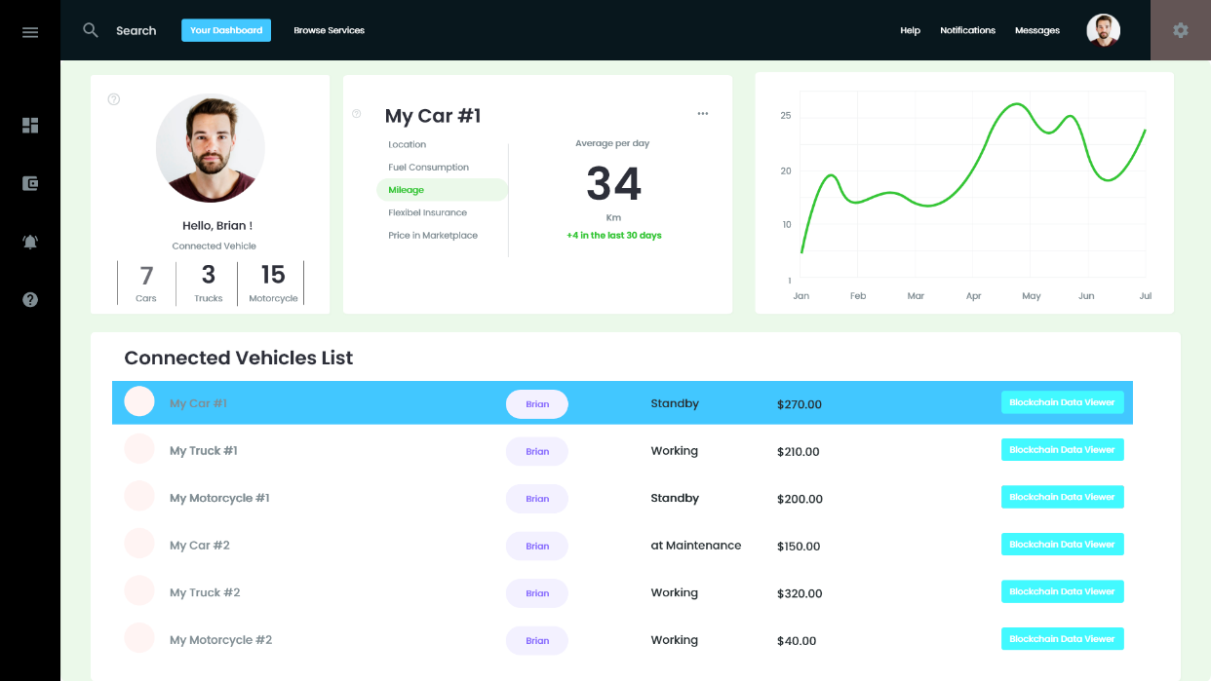
4.a User Interface - Home Dashboard

Slide 6
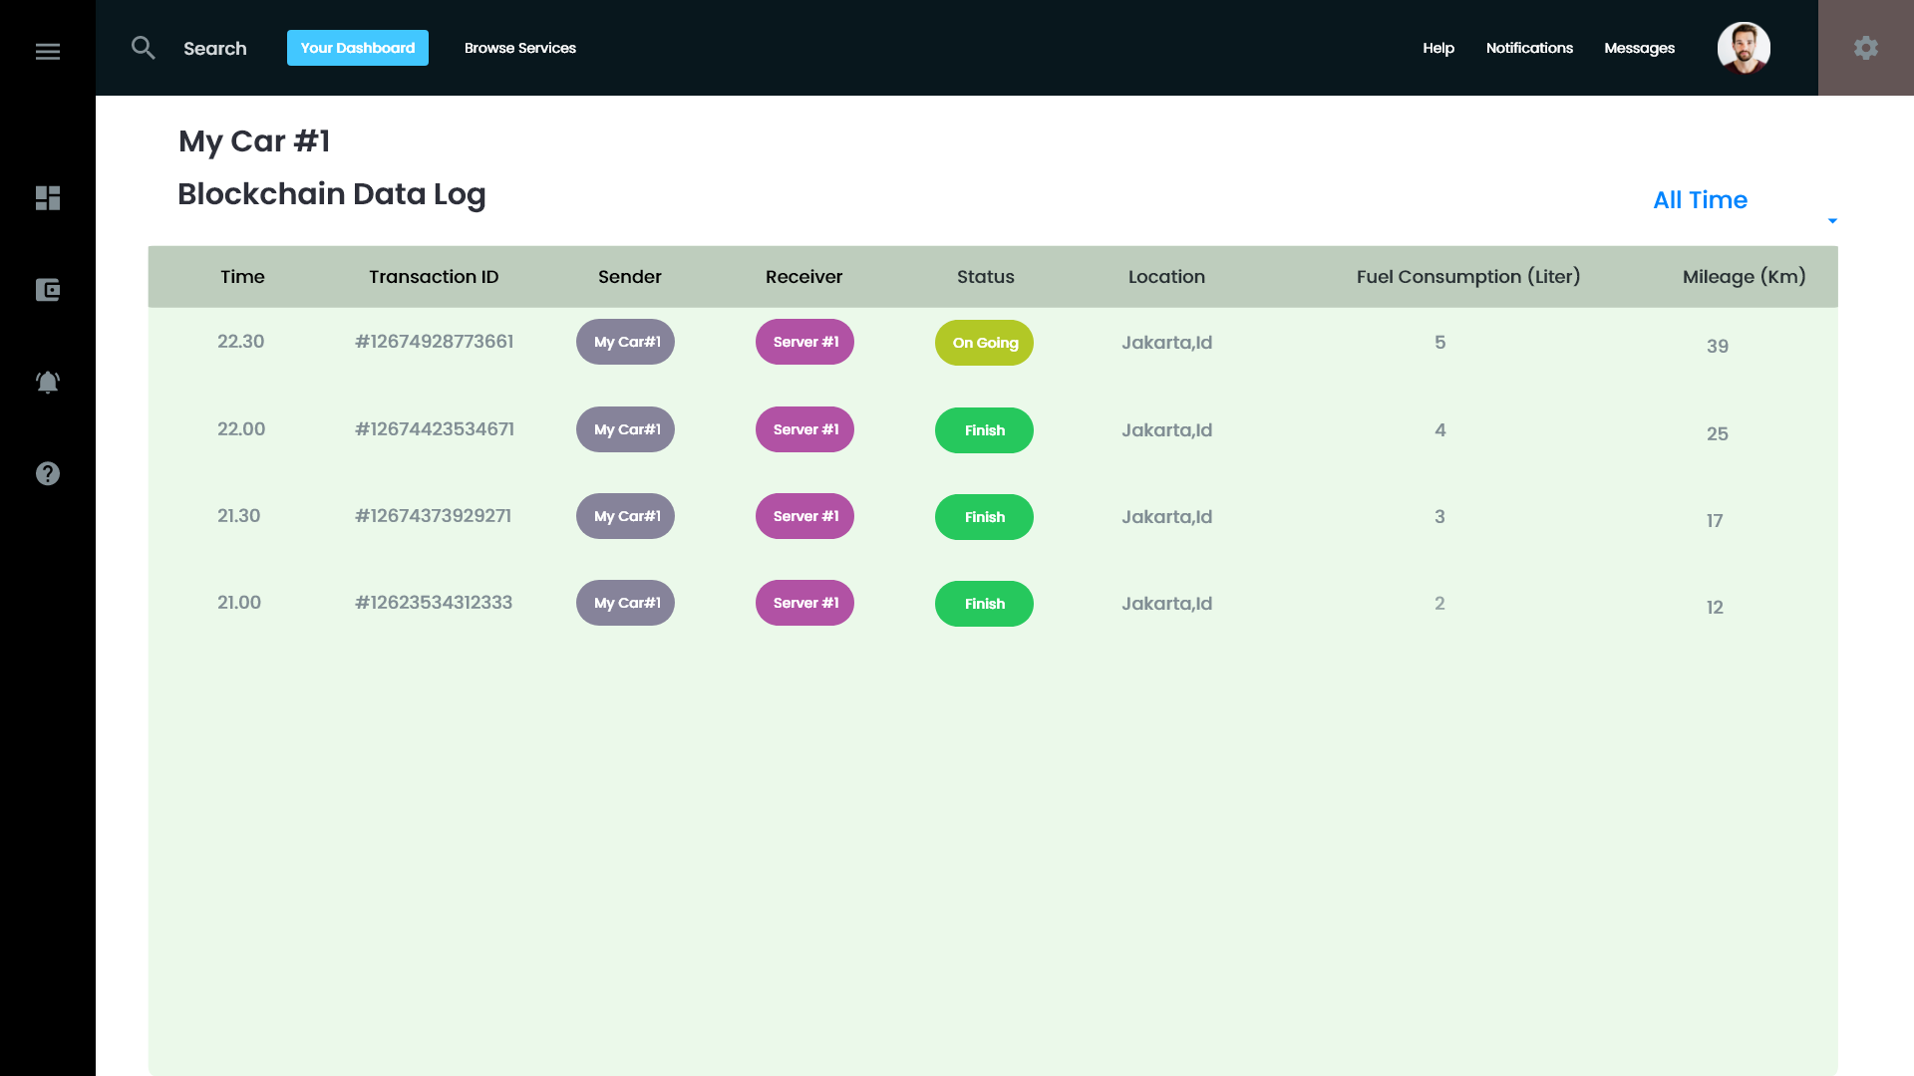
4.b User Interface - Blockchain Data Log - UI

Slide 7
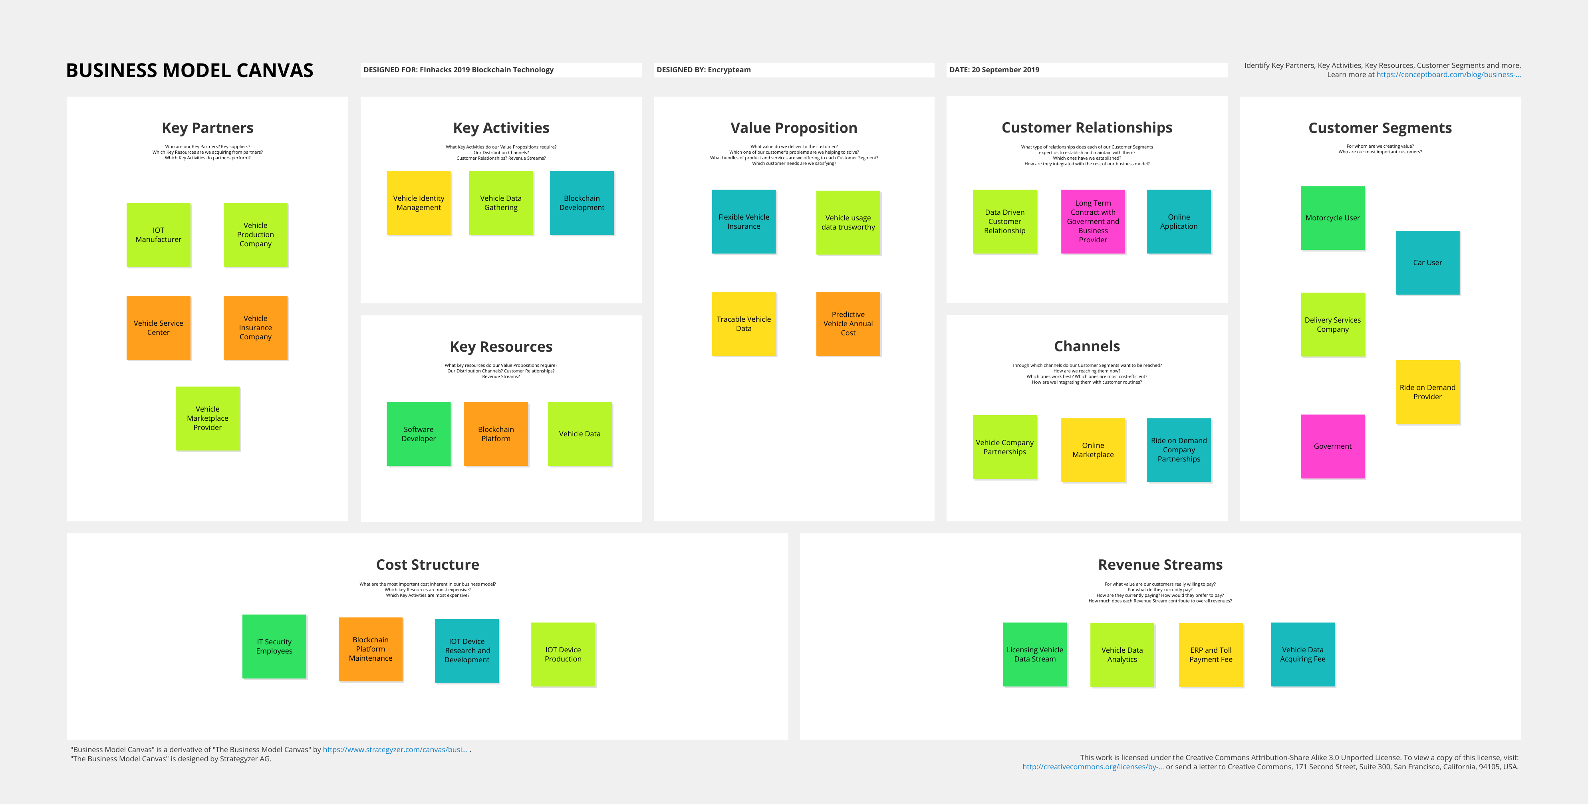

Slide 8
6. Blockchain Platform Utilization
Why does your solution require blockchain? | Does your product require a utility token? If yes, tell us why. | What is your main technical challenge and how do you overcome it? | What is your main business challenge and how do you overcome it?
Blockchain technology is used to strore the vehicle condition data and remove the fraud and manipulation of the vehicle condition data | No We don’t require | Our technical challenge is maintain Internet of things nodes and also blockchain nodes. Solution: Building a coheren system between the IOT device and blockchain platform | Search for the partners and customer for the implementation and installation of the IOT nodes and blockchain nodes to their car.

Slide 9
7. SMART CONTRACTS
Name | Description | Input Variables | Output Variables | Triggering Events
Data Acquisition | Send data from the IOT Device to the storage server | IOT Device A Storage Server A Amount of Data | Transaction ID A | Periodically data acquisition

Slide 10
8. ACTORS
Name | Description
Vehicle Owner / Driver | Sending data of their vehicle to the system. Analysis their cost of fuel and flexible insurance in the Web Apps.
Ride on Demand Provider | Data Subscription. Tracking the driver vehicle condition annually to ensure the maximum safety of the customer
Vehicle Service Center | Data Subscription. Updating the latest vehicle condition to the system with the annul check of the vehicle
Flexible insurance provider | Data Subscription. Updating their insurance fare with the vehicle data based on the region and time from our database
Vehicle Marketplace provider | Using the vehicle data to increase the efficiency to sell the vehicle and also avoid the fraud of vehicle condition.

